Slide 1
Section 7.2 Tangent Properties to a Circle
© Copyright all rights reserved to Homework depot: www.BCMath.ca

Slide 2
I) What is a Tangent Line?
A tangent is a line that intersects a circle at exactly one point and is also outside out the circle
Tangent
Point of Tangency
Not a Tangent!!
Not a Tangent!!
Not a Tangent!!

Slide 3
II) Properties of a Tangent
Perpendicular: A tangent line is perpendicular to the circle’s radius at the point of tangency

Slide 4
EQUAL Distances: Two tangents from the same exterior point to a circle are equal in length
Point “C” is the Exterior Point
Exterior
Point

Slide 5
Ex: Find the value of the “X”

Slide 6
Practice: Find the Missing Sides
Given:

Slide 7
Practice:
Given:

Slide 8
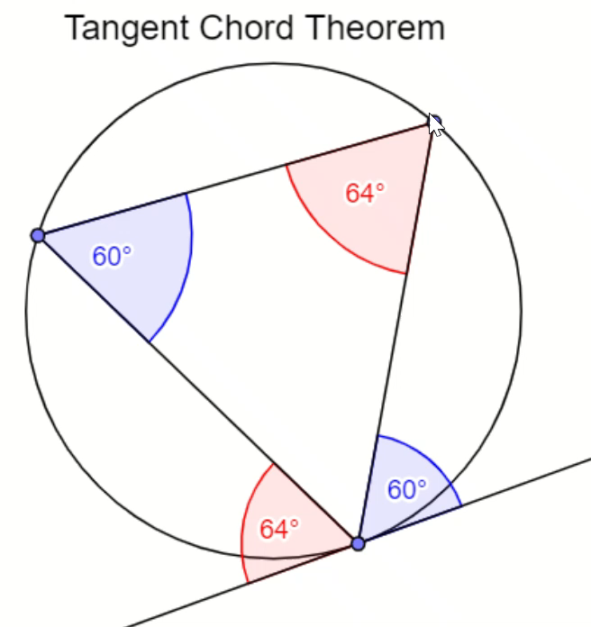
III) T-C Theorem
The angle between a tangent and a chord is equal to the inscribed angle of the chord
Inscribed
Angle
Chord
Tangent
Angle

Slide 9
When using the TC theorem, remember that the angle is between a “Tangent” and “chord”
Not between a “Secant” and “chord”
is the angle between the
Tangent & Chord
Does ?
is the Inscribed angle
of the Chord
NO!
Because the Red Line is
Not a Tangent!!

Slide 10
Proof: Tangent Chord Theorem

Slide 11
Ex: Find the value of each missing Angle

Slide 12
Ex: Find the value of each missing Angle

Slide 13
Ex: Name all Angles equal to “x”
Given: All blue line segments are
equal in length
Red Line is a tangent

Slide 14
Practice:

Slide 15
IV) Proving Tangent Properties
The Radius is perpendicular to the tangent at the point of Tangency
AC is a secant/chord
AC is bisected by OB
So AC is perpendicular to OB
If we move AB away from
the center, OB is still
perpendicular to AC
Eventually, AC is moved to the edge
and becomes a tangent. Points
A & C are moved to point B.
OB (radius) is perpendicular to the
AC (tangent)

Slide 16
Practice: Prove
Tangents of a circle from the same exterior point are equal in length
Given:
Prove:
Statement | Reason

Slide 17
In the diagram, AB, AC, and DE are all tangents to the circle centered at “O”. If angle “A” is equal to 20degrees, what is the value of angle DOE?
Hint #1: Draw the Radii
Hint #2: Identify all congruent triangles
Hint #3: ABOC is an quadrilateral, find angle BOC
Hint #4: Which angles are equal?

Slide 18
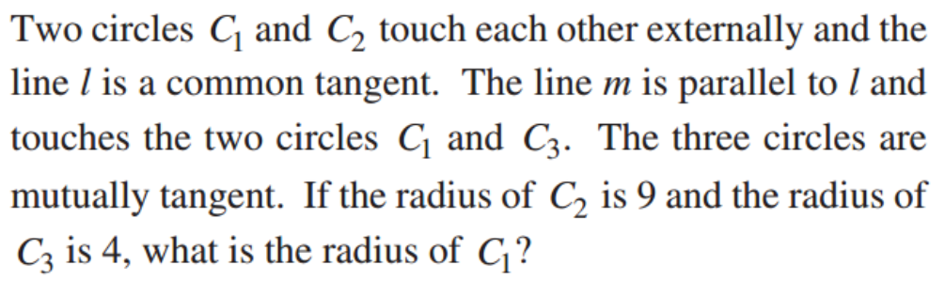
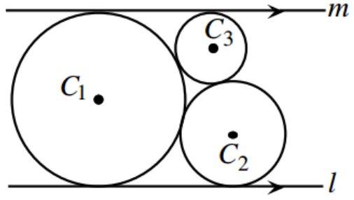
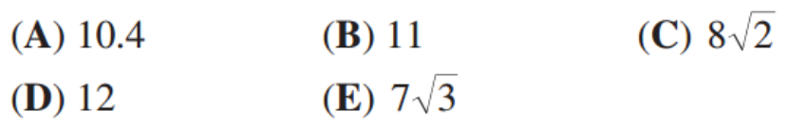
Hint #1: What is the most important point of a circle
Answer: The center, so connect them

